Slide 1
POWER-TAXI
A Safe ride for you and your loved ones

Slide 2
Case Study
Travelling in Cabs is still considered unsafe in many parts of India, especially when its night or the Ladies and Children are travelling alone in the cab. Ola and Uber are well-used, but they aren't completely safe either.

Slide 3
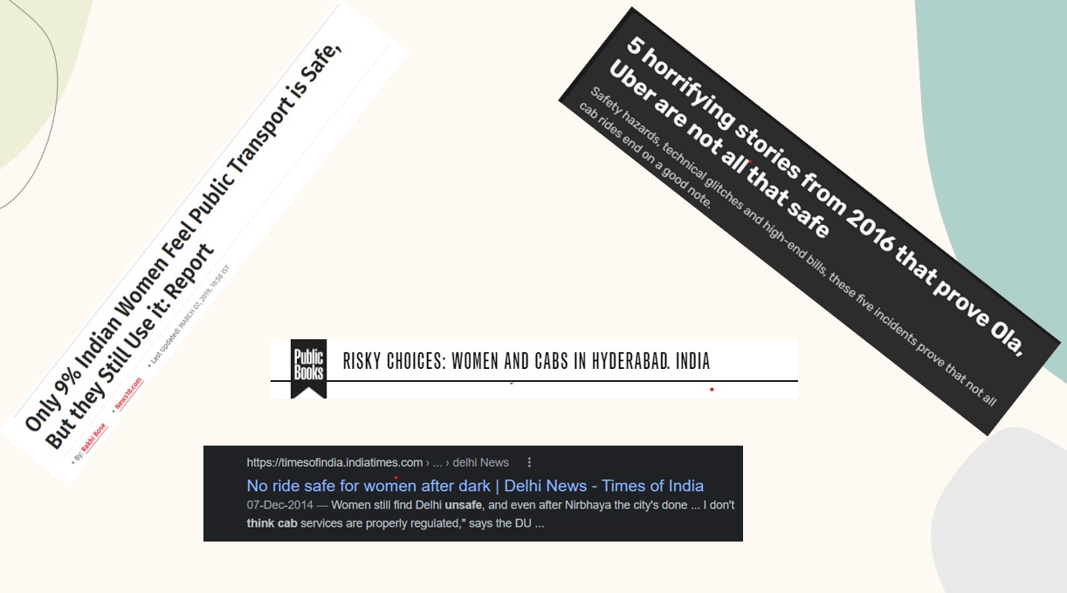
We see them often in our Newspapers!!
Can we do something about it??

Slide 4
Two Step Solution for Problem
Safer cab rides
(Specially at nights)
Better hiring process for drivers
Better monitoring of cabs
Training and Procedures for application as a driver, special emphasis to promote female drivers
Basic safety equipment’s , CCTV,
Realtime location tracking by organisation as well as guardians

Slide 5
Solution
Better hiring process for drivers: Training and Testing
(Both physically& mentally)
Procedures for application as a driver, special emphasis to promote female drivers.
The Army Veterans and Trained NCC candidates to be chosen which ensures complete protection of the passengers. (USP)
Better monitoring of cabs: Installing a CCTV inside the cab to monitor, Emergency buttons present both in cab and the app.
Realtime Location tracking and supervision by our team.

Slide 6
Bottom – Top approach for Solution
Top level
Safer Riding Experience
Ultimately providing the passenger with safest rides
2nd level
Button based alert system
System alerting nearby safety authorities
1st Level
Modification of cabs
Modifying the car according to safety standards
Root level
Drivers
Background check , Skill test , Training

Slide 7
Progress Report
*Report conducted on 150 people from each group

Slide 8
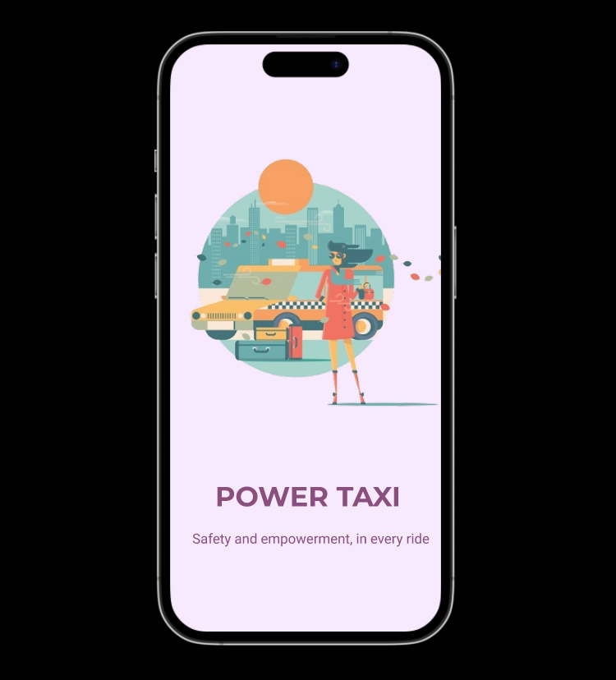
Application
Prototype

Slide 9
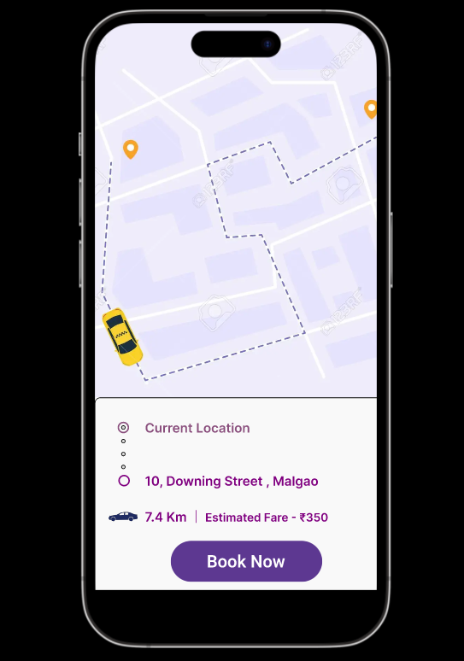
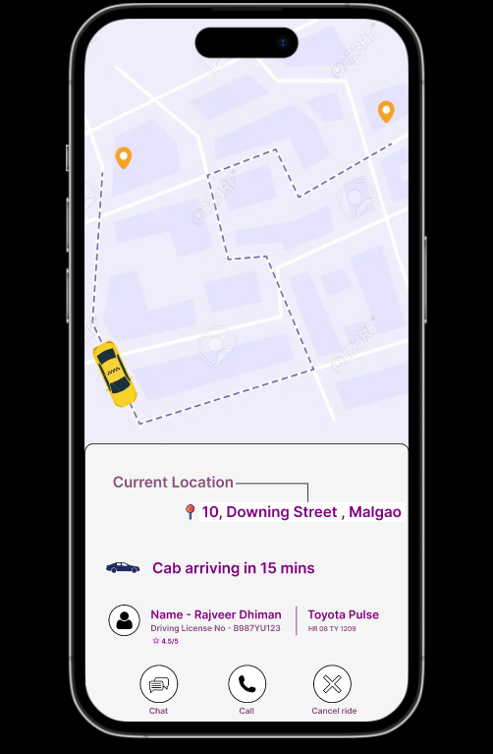

Slide 10
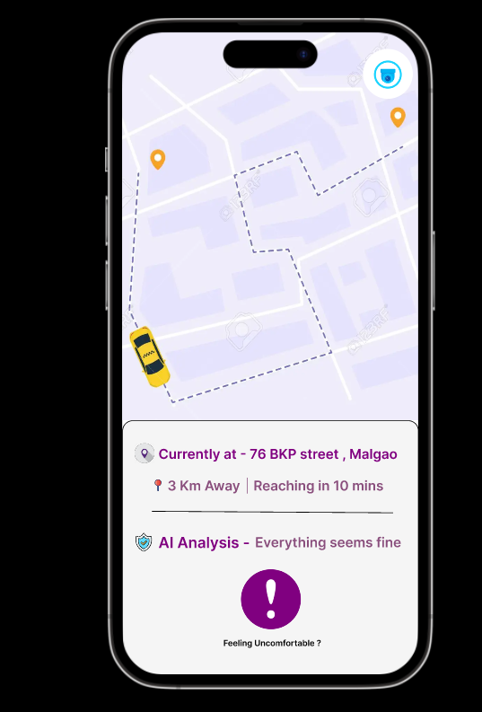
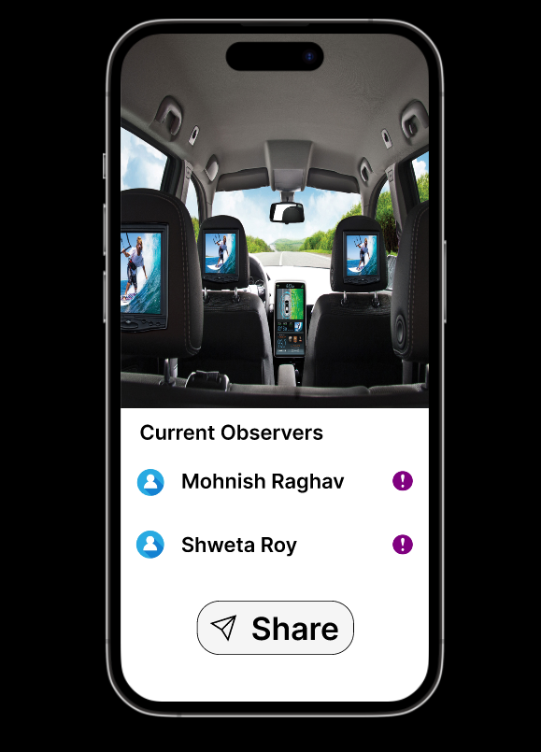

Slide 11
Features of App
Details of Driver
AI based App
Sharing the full details of driver including driver license
Monitoring speed , traffic and updating it to users
Camera access
QRT Service
Giving camera access to get a real time analysis of issue (if any)
Quick Response Team network and service.
Customer Care
Emergency Button
Any issues faced during ride and other services
When customer face fear the emergency team will come

Slide 12
Alert System
01
Police Stations
Informing the nearest police station giving GPS location and surveillance access
24*7 associates
02
Providing immediate help and necessary safety measures.
03
NCC cadets
Informing the volunteering NCC cadets in that region.

Slide 13
Intervention of Govt and Company
Training
Training by Ex-Army officers and experienced psychiatrist.
Govt Schemes
Tying up with govt organisations that are continously trying to empower this sector
Funding
Various NGOs and Angel Investors are showing up the interest in this field.

Slide 14
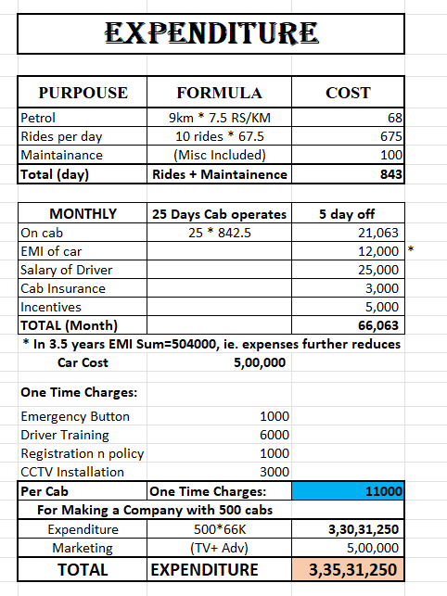
Monthly Expenditure (Revised)

Slide 15
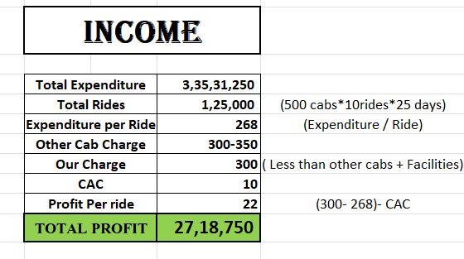
Monthly Income (Revised)

Slide 16
Why Ola and Uber cannot Copy the same and implement in their system?
Both the companies are at huge losses after the pandemic and the average driver salary is around 15K which is also given after 3 months (sometimes more)
In both this Unicorns, the cars are individually purchased by the drivers, and they just create the platform to meet the needs of the Passenger and Driver respectively.
They have already spent around $194 million (together) in their field, so to change their business model at this particular stage, it is next to impossible.
Both of these Biggies have absolutely no check on the drivers background. They just need a DL and a well equipped cabs. Currently together they have around 25 lacs drivers(In India) and now if they try to impose the same on every driver, they will loose market credibility.

Slide 17
How to grow this business!!
Tying up with Different schools and Colleges to apply our idea in their public transport, so that both the parents and the staff of the institution can keep a track of them.
Providing the facilities at Tourist Destinations and Pilgrimage Places.
Tying up with INA and Defence forces to allow them to train our drivers at lower cost.
Making the app faster and User Friendly and providing it in local languages too. Also including the voice feature in the app will enhance its ability.

Slide 18
THANKING YOU!!
PROPOSED BY:- KISHAN PERIWAL

